Slide 1
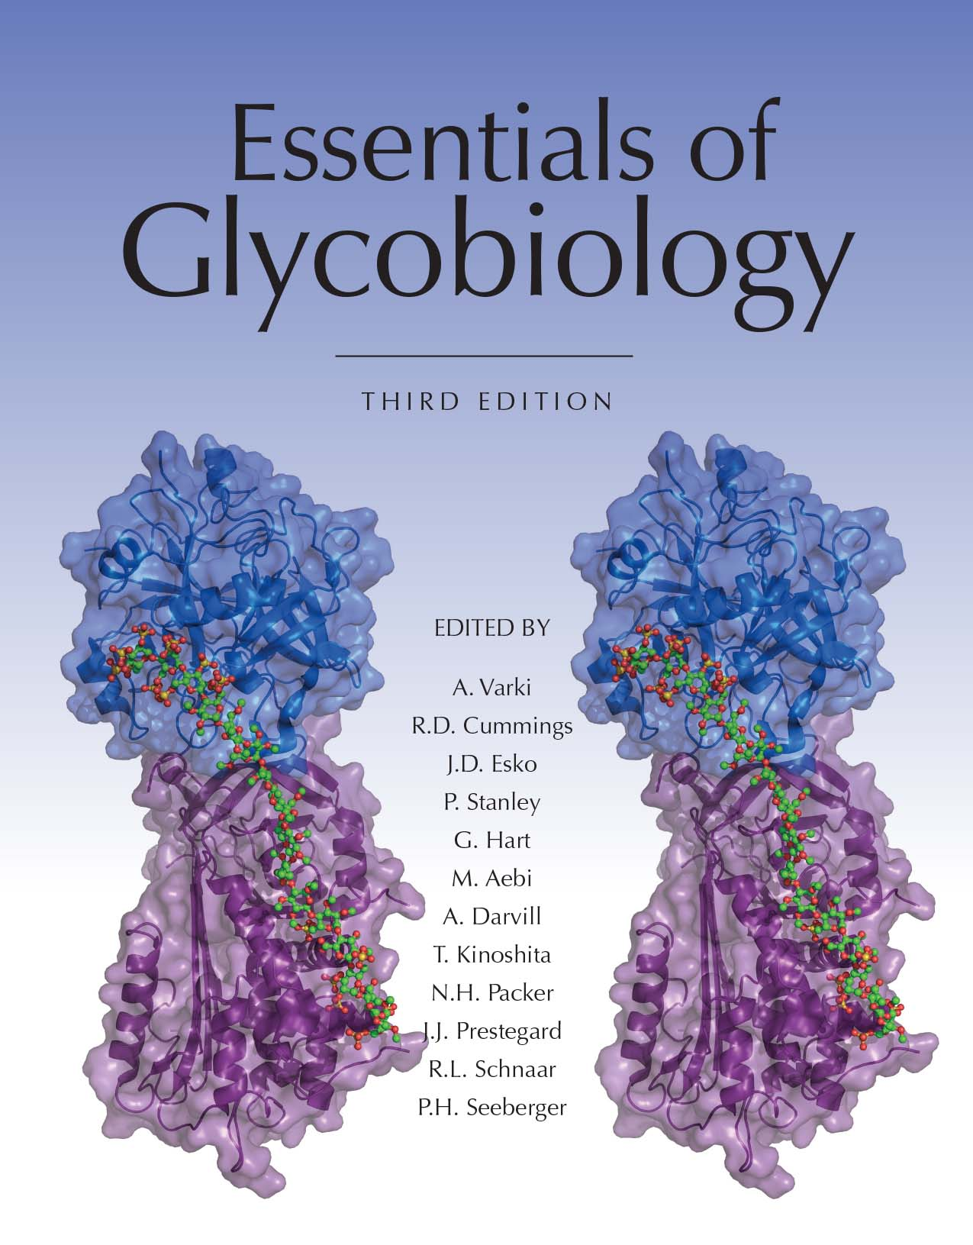
Dolichol Phosphate (Dol-P)
Chapter 9, Figure 2. Essentials of Glycobiology, Third Edition
Buy the Book
©2017 The Consortium of Glycobiology Editors, La Jolla, California
Notes:
FIGURE 9.2. Dolichol phosphate (Dol-P). N-Glycan synthesis begins with the transfer of GlcNAc-1-P from UDP-GlcNAc to Dol-P to generate dolichol pyrophosphate N-acetylglucosamine (Dol-P-P-GlcNAc). This reaction is inhibited by tunicamycin.
(Note: Embedded links are present but live only in the slide display mode.)

