Slide 1
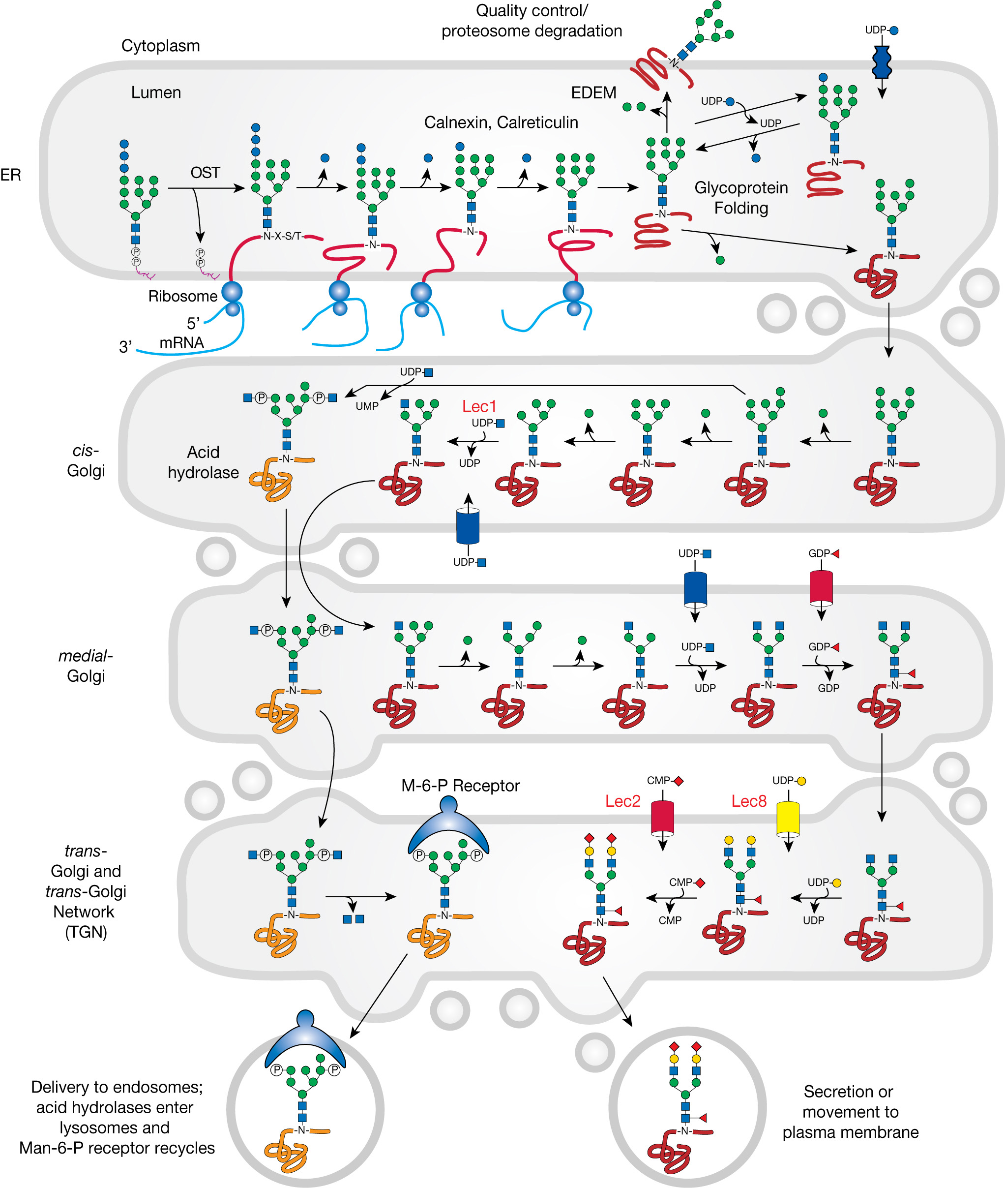
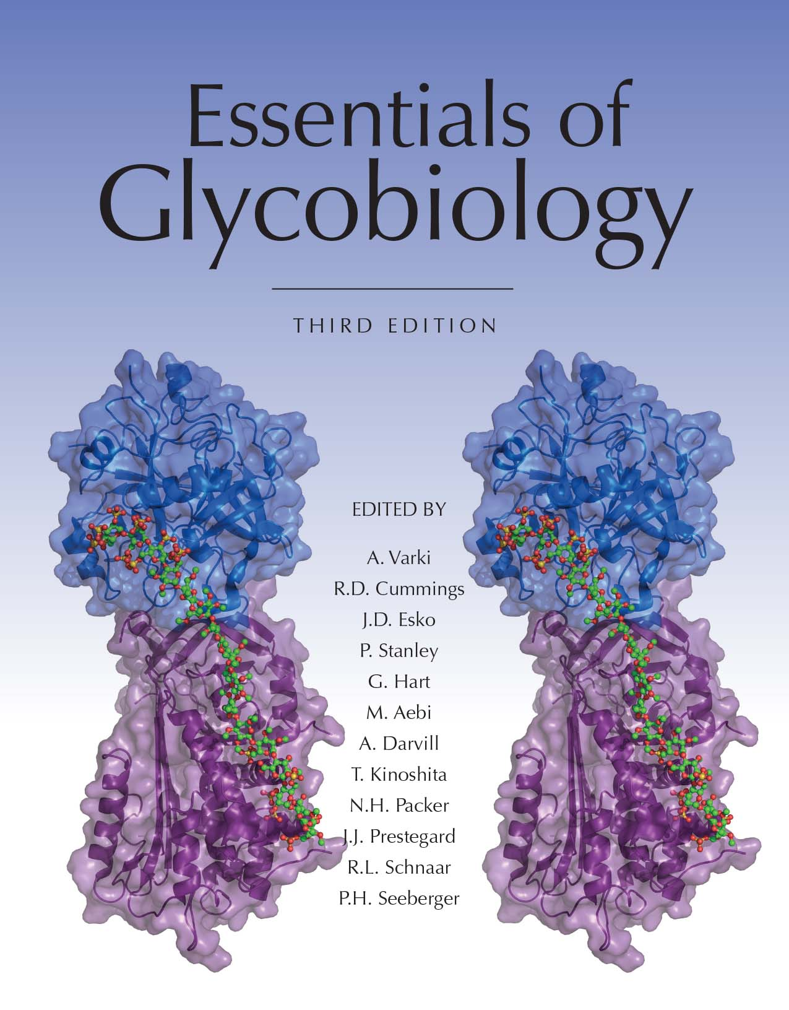
Processing and Maturation of an N-Glycan
Chapter 9, Figure 4. Essentials of Glycobiology, Third Edition
Symbol Nomenclature for Glycans (SNFG)
Buy the Book
©2017 The Consortium of Glycobiology Editors, La Jolla, California
Notes:
FIGURE 9.4. Processing and maturation of an N-glycan. The mature glycan attached to Dolichol-P-P (Figure 9.3) is usually transferred to Asn-X-Ser/Thr sequons during protein synthesis as proteins are being translocated into the endoplasmic reticulum (ER). Some transfer may also occur after translocation is complete. Following transfer of Glc₃Man₉GlcNAc₂ to protein, glucosidases in the ER remove three Glc residues, and ER mannosidase removes a Man residue. These reactions are intimately associated with the folding of the glycoprotein assisted by the lectins calnexin and calreticulin, which determine whether the glycoprotein continues to the Golgi or is degraded. Another lectin, termed ER degradation-enhancing α-mannosidase I–like protein (EDEM), binds to Man residues on misfolded glycoproteins and escorts them via retrotranslocation into the cytoplasm for degradation. The removal of the first Glc (and therefore all Glc) can be experimentally blocked by castanospermine, leaving Glc₃Man₉GlcNAc₂, which may subsequently have terminal Man residues removed during passage through the Golgi. For most glycoproteins, additional Man residues are removed in the cis compartment of the Golgi until Man₅GlcNAc₂ is generated. The experimental mannosidase inhibitor deoxymannojirimycin blocks the removal of these Man residues, leaving Man₈GlcNAc₂, which is not further processed. The action of MGAT1 on Man₅GlcNAc₂ in the medial-Golgi initiates the first branch of an N-glycan. This reaction is blocked in the Lec1 CHO mutant in which MGAT1 is inactive, leaving Man₅GlcNAc₂, which is not further processed. α-mannosidase II removes two outer Man residues in a reaction that may be experimentally blocked by the inhibitor swainsonine. The action of α-mannosidase II generates the substrate for MGAT2. The resulting biantennary N-glycan is extended by the addition of Fuc, Gal, and Sia to generate a complex N-glycan with two branches. The addition of Gal does not occur in Lec8 CHO mutants, which have an inactive UDP-Gal transporter. Thus, in Lec8 mutants, complex N-glycans terminate in GlcNAc. The addition of Sia does not occur in the Lec2 CHO mutant, which has an inactive CMP-Sia transporter. In Lec2 mutants, complex N-glycans terminate in Gal. Complex N-glycans can have many more sugars than shown in this figure, including additional residues attached to the core, additional branches, branches extended with poly-LacNAc units, and different “capping” epitopes (Chapter 14). Also shown is the special case of lysosomal hydrolases that acquire a GlcNAc-1-P at C-6 of Man residues on oligomannose N-glycans in the cis-Golgi. The GlcNAc is removed in the trans-Golgi by a glycosidase, thereby exposing Man-6-P that is recognized by a M6PR and routed to an acidified, prelysosomal compartment (Chapter 33). Chemical inhibitors of N-glycan processing are described in Chapter 55, and CHO mutants blocked in N-glycan synthesis are described in Chapter 49. (Adapted, with permission of the Annual Review of Biochemistry, from Kornfeld R, Kornfeld S. 1985. Annu Rev Biochem 54: 631–634. Original art has been adapted and redrawn by R.D. Cummings.)
(Note: For a key to symbols used for monosaccharides, use the SNFG link. Embedded links are present but live only in the slide display mode.)

