Slide 1
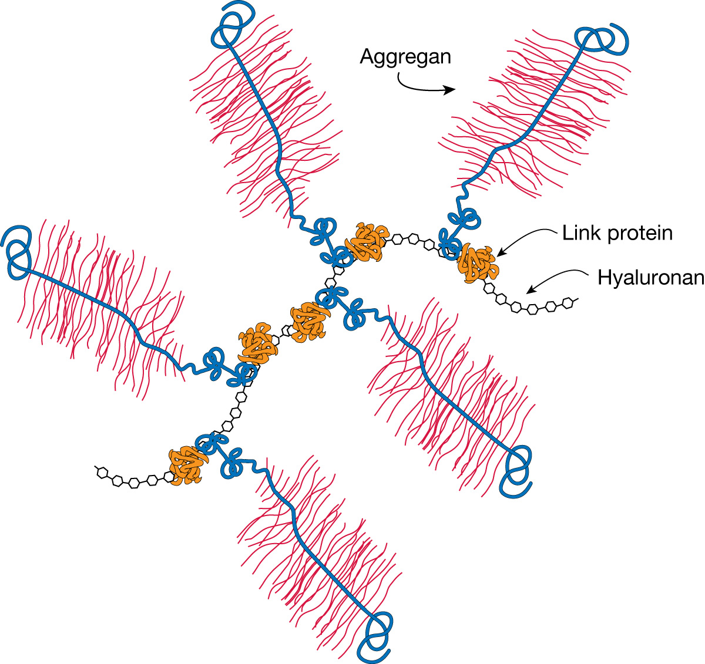
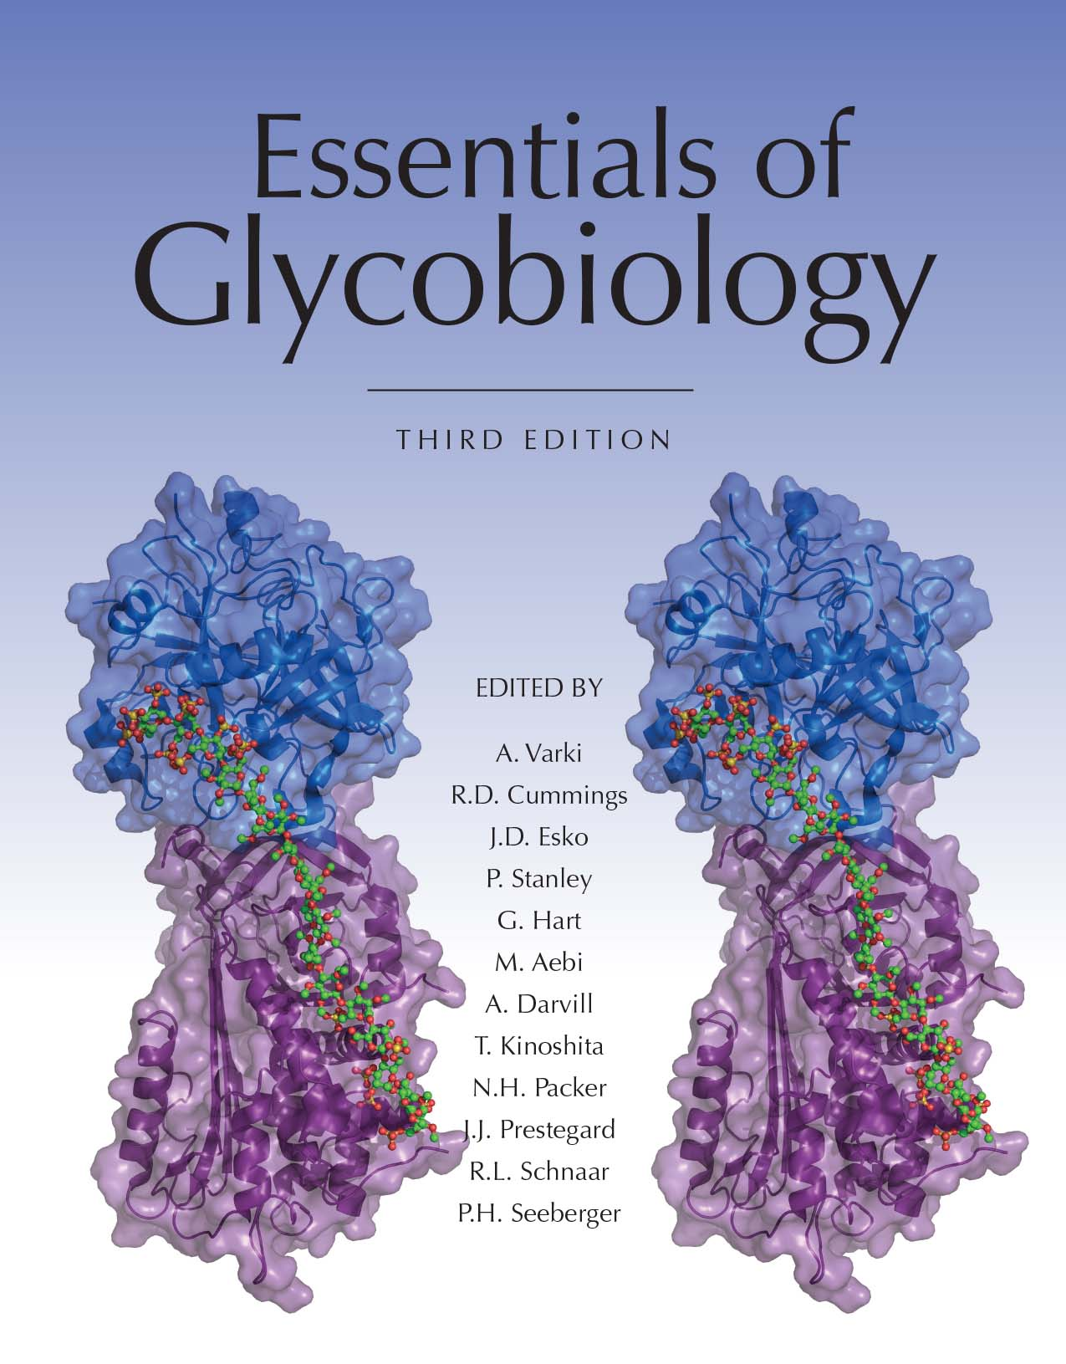
The Large Cartilage Chondroitin Sulfate Proteoglycan
Forms an Aggregate
Chapter 16, Figure 4. Essentials of Glycobiology, Third Edition
Buy the Book
©2017 The Consortium of Glycobiology Editors, La Jolla, California
Notes:
FIGURE 16.4. The large cartilage chondroitin sulfate (CS) proteoglycan (aggrecan) forms an aggregate with hyaluronan and link protein.
(Note: Embedded links are present but live only in the slide display mode.)

