Slide 1
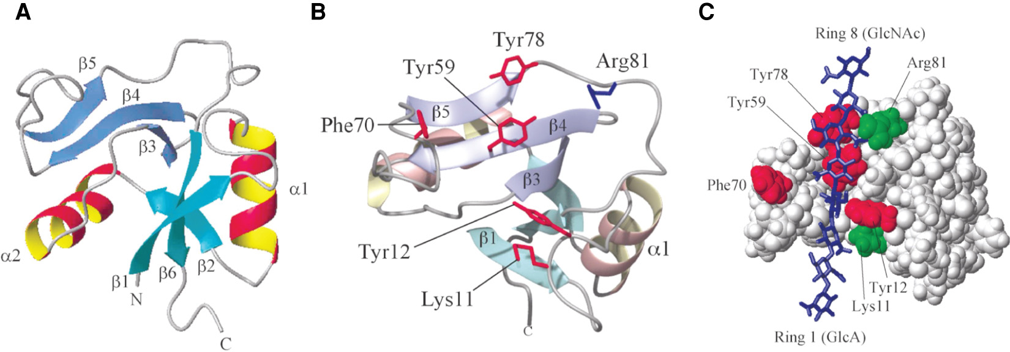
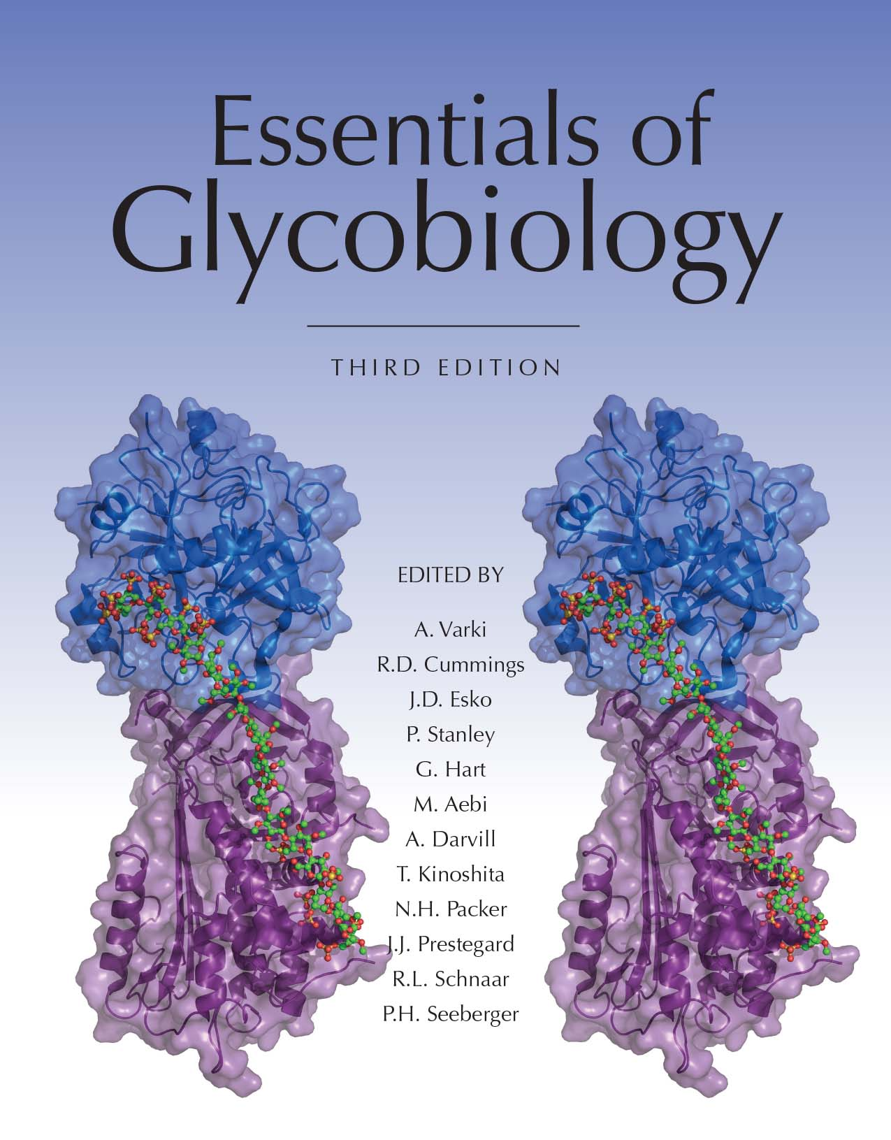
Structure of the Link Module
Chapter 16, Figure 5. Essentials of Glycobiology, Third Edition
Buy the Book
©2017 The Consortium of Glycobiology Editors, La Jolla, California
Notes:
FIGURE 16.5. Structure of the link module. (A) TSG-6 contains a prototypical link module defined by two α-helices (α1 and α2) and two triple-stranded antiparallel β-sheets (β1,2,6 and β3–5). (Redrawn, with permission, from Blundell CD, et al. 2003. J Biol Chem 278: 49261–49270, © American Society for Biochemistry and Molecular Biology. Original art has been adapted and redrawn by R.D. Cummings.) (B) The hyaluronan-bound conformation of the protein, with a view showing key amino acids. (Redrawn, with permission, from Blundell CD, et al. 2004. In Chemistry and biology of hyaluronan [eds. Garg HC, Hales CA], pp. 189–204, © Elsevier. Original art has been adapted and redrawn by R.D. Cummings.) (C) A model of the TSG-6 link module/hyaluronan complex. Binding of the hyaluronan to the protein is mediated through ionic interactions between positively charged amino acid residues (green) and the carboxylate groups of the uronic acids and by a combination of aromatic ring stacking and H-bond interactions between the polysaccharide and aromatic amino acids (red). In addition, hydrophobic pockets (on either side of Tyr59) can accommodate the methyl groups of two N-acetylglucosamine side chains, which is likely to be a major determinant in specificity of link modules for hyaluronan. (Redrawn, with permission, from Blundell CD, et al. 2005. J Biol Chem 280: 18189–18201, © American Society for Biochemistry and Molecular Biology. Original art has been adapted and redrawn by R.D. Cummings.)
(Note: Embedded links are present but live only in the slide display mode.)

