Slide 1
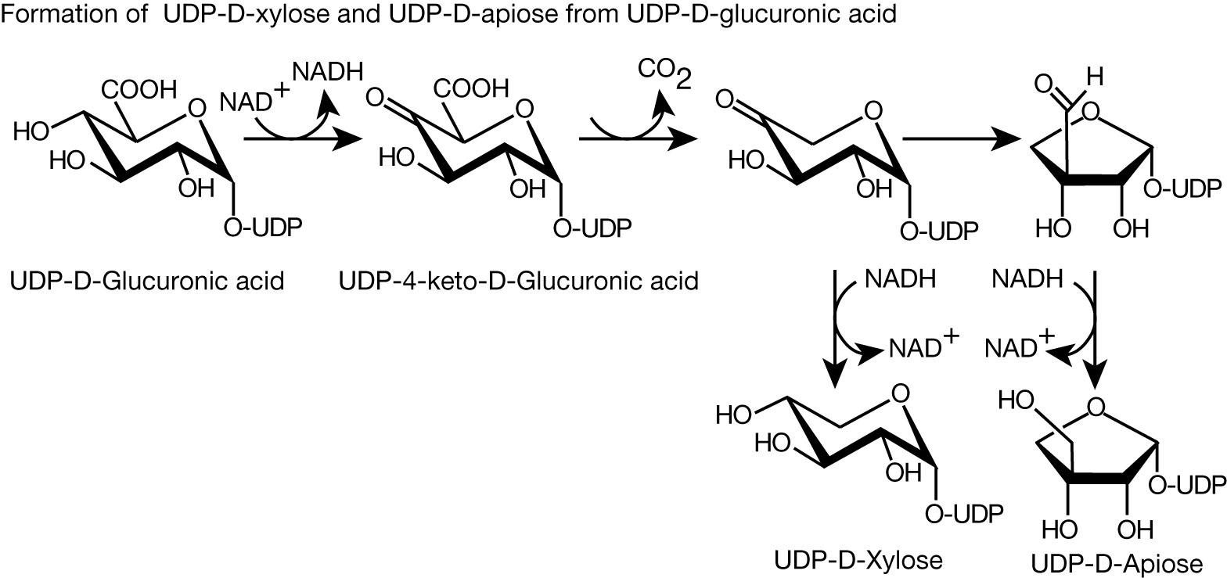
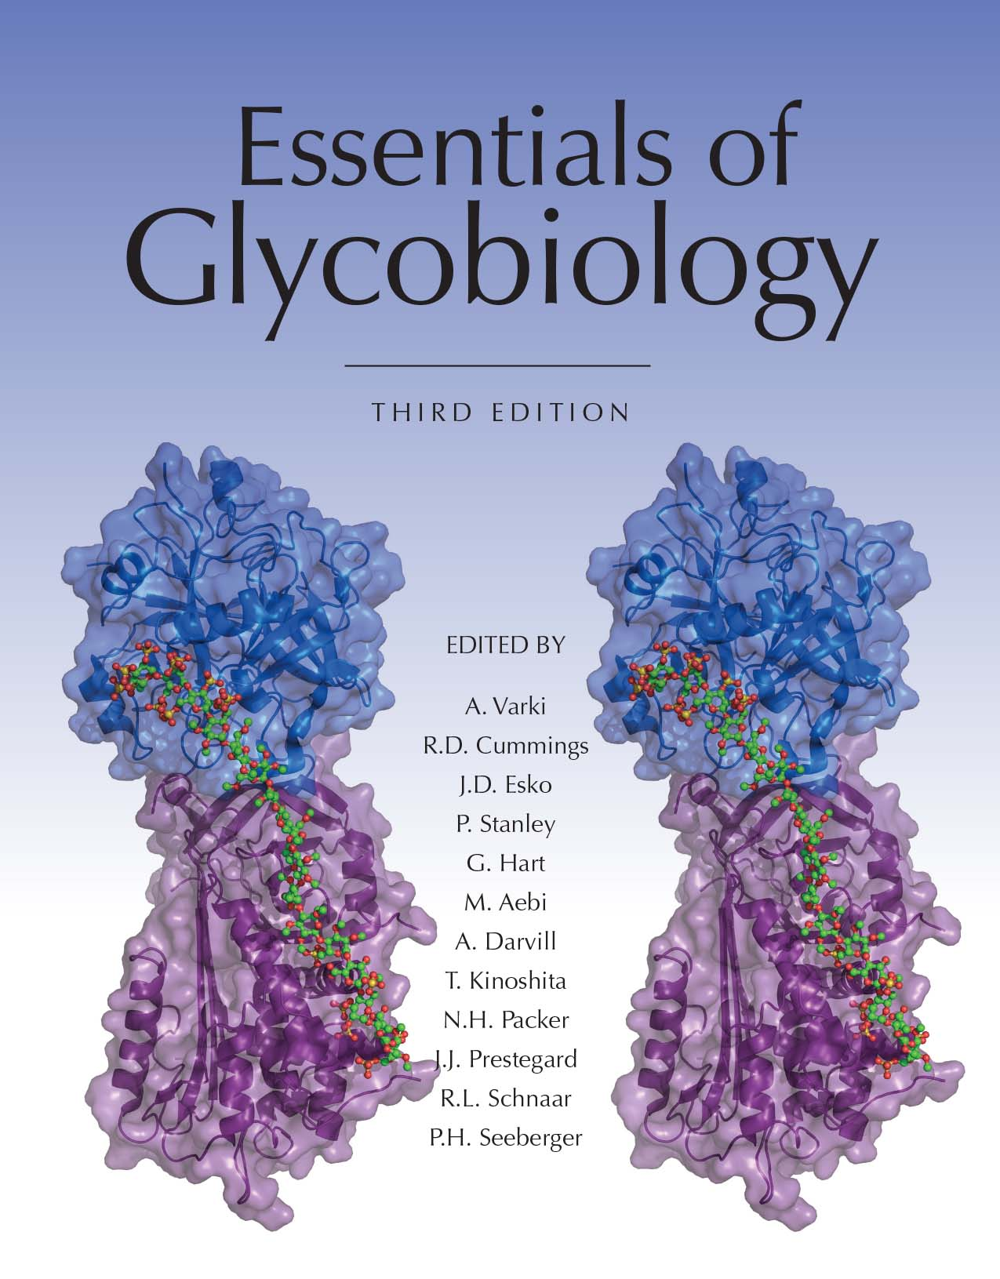
Biosynthesis of UDP-Xylose and the Branched Sugar Donor UDP-Apiose
Chapter 5, Figure 2. Essentials of Glycobiology, Third Edition
Buy the Book
©2017 The Consortium of Glycobiology Editors, La Jolla, California
Notes:
FIGURE 5.2. Biosynthesis of UDP-xylose and the branched sugar donor UDP-apiose from UDP-GlcA. Xylose is found in animals and plants, whereas apiose is used for plant polysaccharides such as apiogalacturonan in Lemna minor. Note the similarity and overlap in the synthesis of xylose and apiose. The only differences are that the C-3 is removed by an unknown mechanism, and the reduction of the newly formed aldehyde creates the branched sugar donor.
(Note: Embedded links are present but live only in the slide display mode.)

