Slide 1
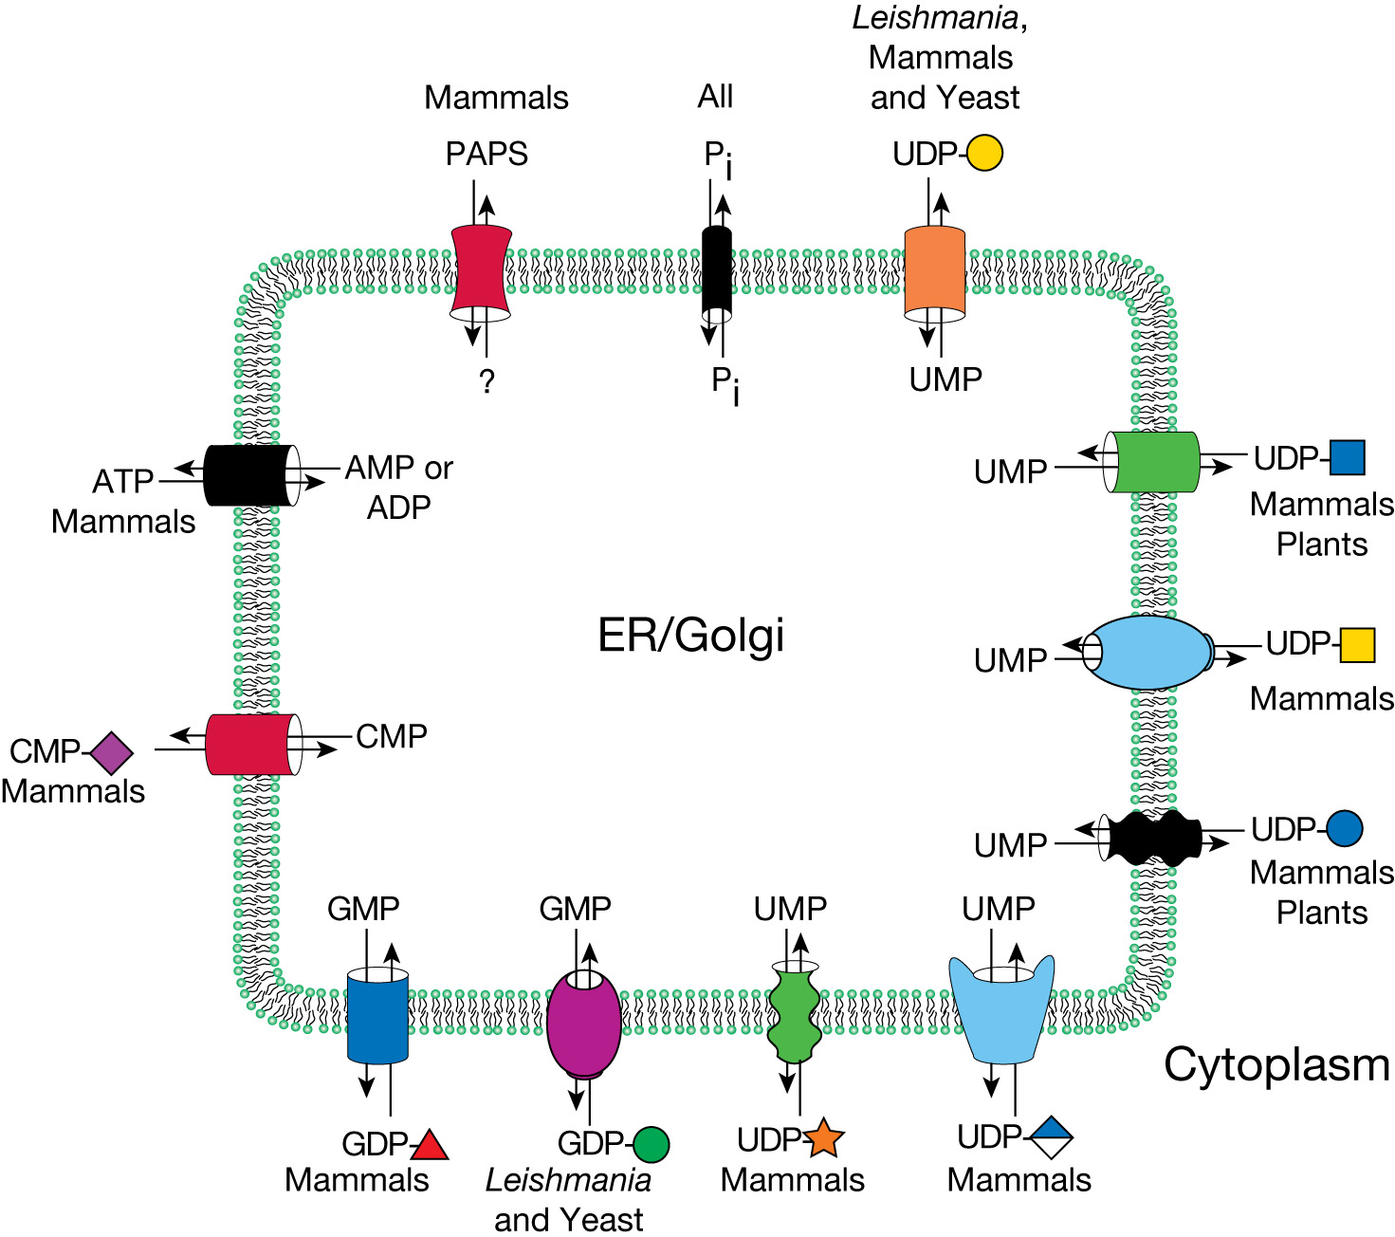
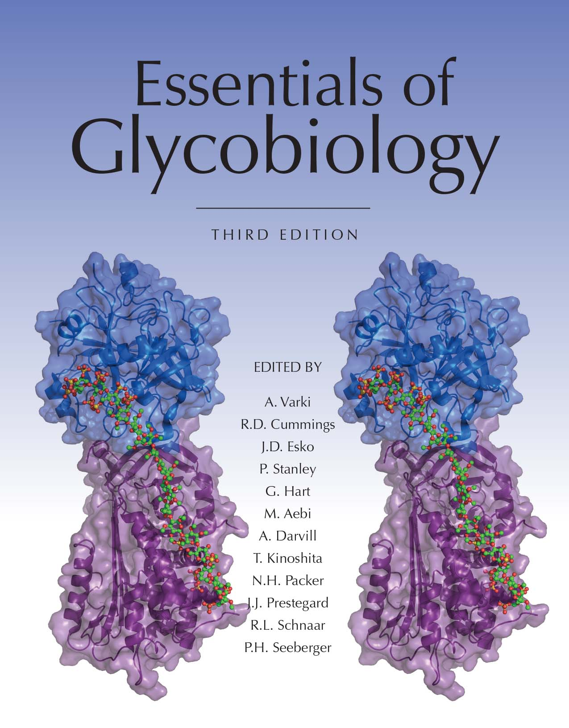
Some Known Transporters for Nucleotide Sugars
Chapter 5, Figure 4. Essentials of Glycobiology, Third Edition
Symbol Nomenclature for Glycans (SNFG)
Buy the Book
©2017 The Consortium of Glycobiology Editors, La Jolla, California
Notes:
FIGURE 5.4. Some known transporters for nucleotide sugars, PAPS (3′-phosphoadenosine-5′-phosphosulfate), and ATP are located in the Golgi membranes of mammals, yeast, protozoa, and plants. These proteins are antiporters and return the corresponding nucleoside monophosphate back to the cytoplasm when the nucleotide sugar is delivered into the endoplasmic reticulum (ER) or Golgi compartment. Because most glycosylation reactions produce a nucleoside diphosphate, this requires conversion to the nucleoside monophosphate. For PAPS, the corresponding exiting molecule is unknown, and for ATP, it is AMP, ADP, or both. The phosphate (P_{i}) transporter is hypothetical. See Online Appendix 1B for full names and designated symbols for monosaccharides.
(Note: For a key to symbols used for monosaccharides, use the SNFG link. Embedded links are present but live only in the slide display mode.)

