Slide 1
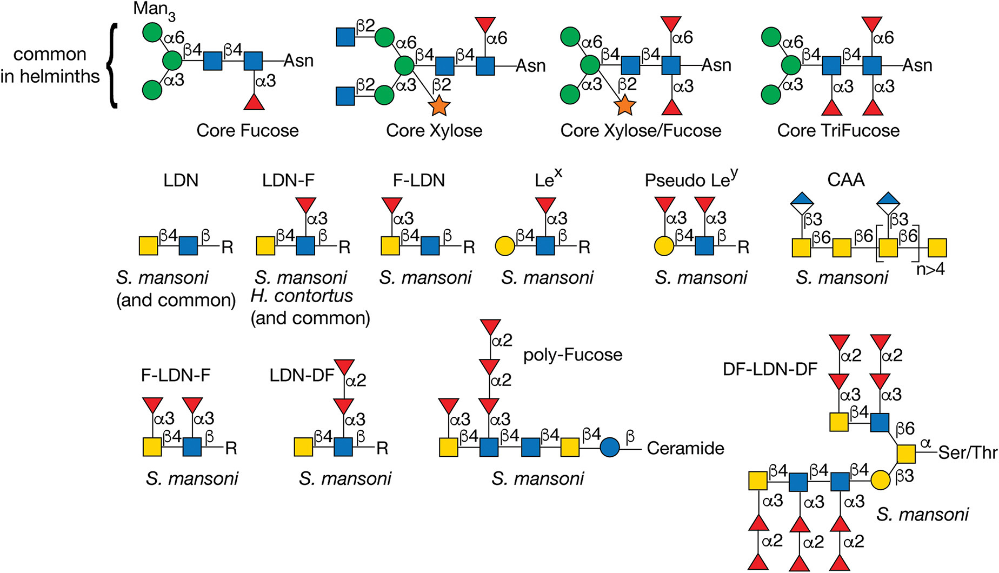
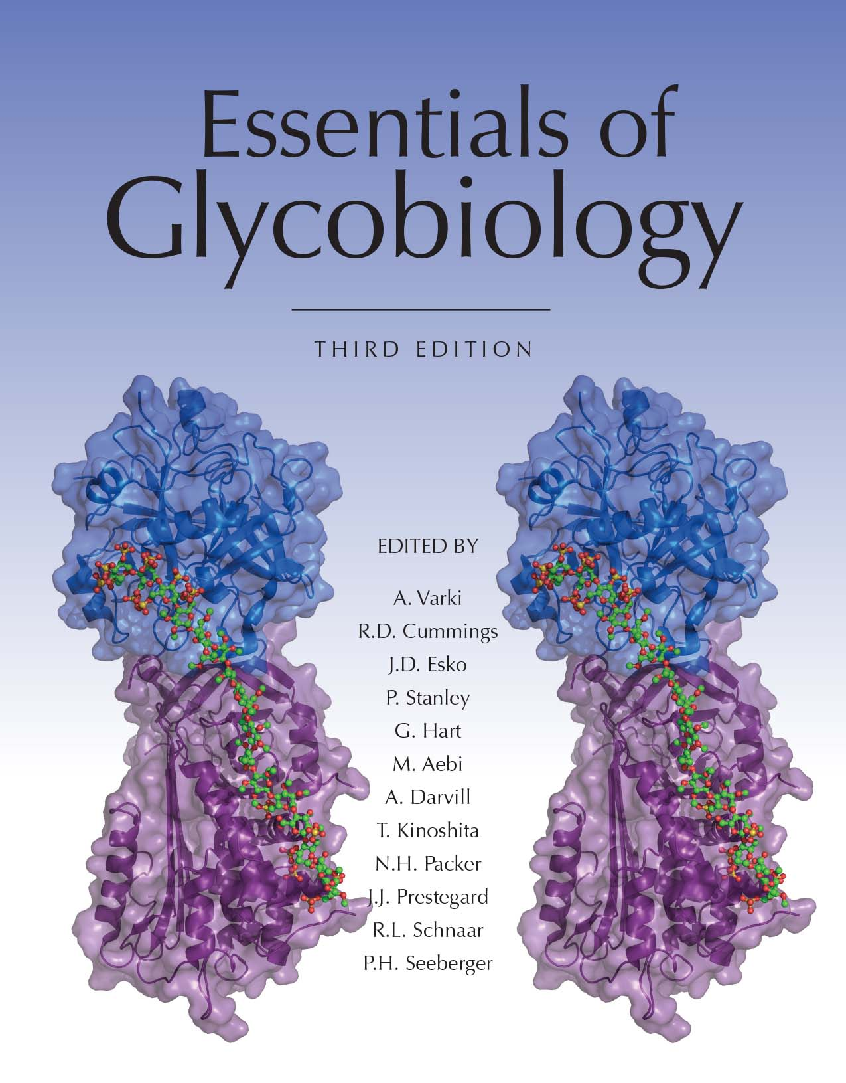


Structures of Glycans Found in Parasitic Helminths
Chapter 43, Figure 8. Essentials of Glycobiology, Third Edition
Symbol Nomenclature for Glycans (SNFG)
Buy the Book
©2017 The Consortium of Glycobiology Editors, La Jolla, California
Notes:
FIGURE 43.8. Structures of glycans found in parasitic helminths, including Schistosoma mansoni and Haemonchus contortus. The antigens are indicated by the structures within the brackets. (LDN) LacdiNAc; (Le^{x}) Lewis x; (CAA) circulating anodic antigen; (F-) fucosylated; (DF-) difucosylated.
(Note: For a key to symbols used for monosaccharides, use the SNFG link. Embedded links are present but live only in the slide display mode.)

