Slide 1
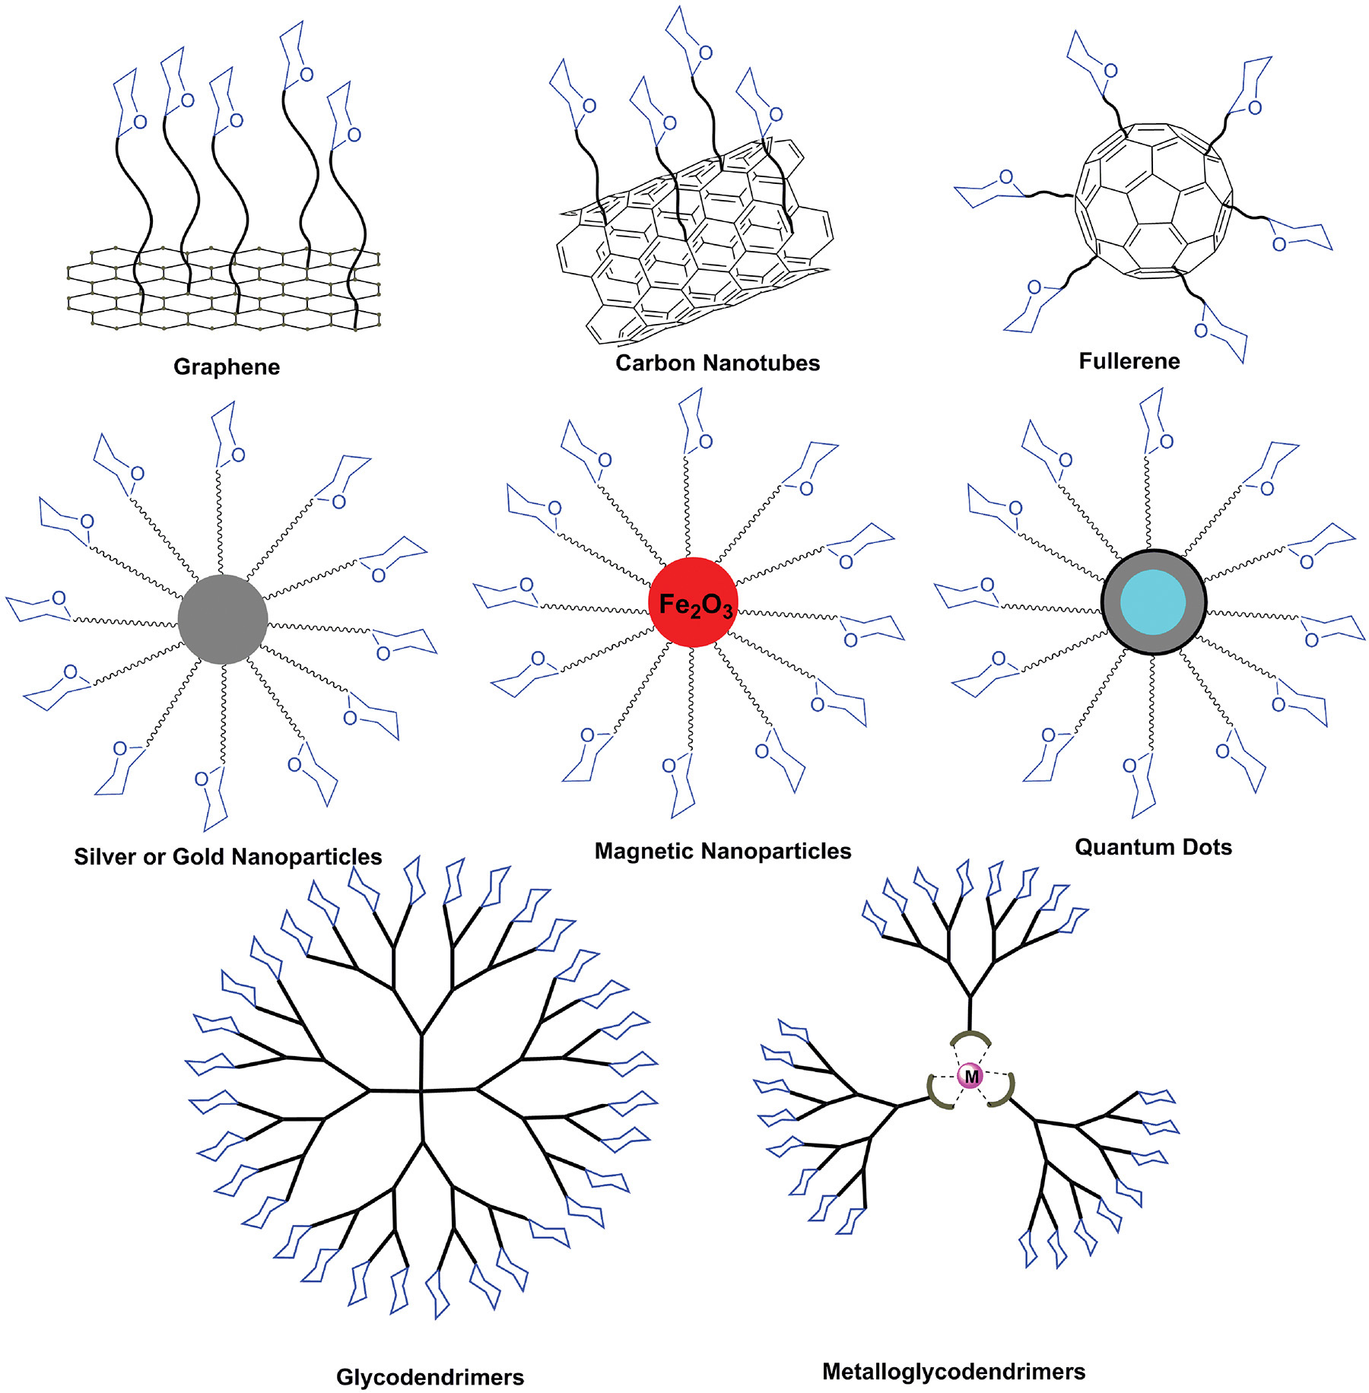
Overview of Different Types of Glyconanomaterials
Chapter 58, Figure 1. Essentials of Glycobiology, Third Edition
Buy the Book
©2017 The Consortium of Glycobiology Editors, La Jolla, California
Notes:
FIGURE 58.1. Overview of different types of glyconanomaterials created by coupling glycans to the surface of diverse nanomaterials.
(Note: Embedded links are present but live only in the slide display mode.)

